Slide 1

2019
1

Slide 2
Data Science and AI
Module 1
Part 2:
Python for Data Science
2

Slide 3
Agenda: Module 1 Part 2
Python Fundamentals
Software Engineering Best Practices
Using Git & GitHub for Version Control
3

Slide 4
Python Fundamentals
Programming Data Science in Python
Developing and running Python
Data structures in Python
Writing functions in Python
Iterating in Python
numpy, pandas, scikit-learn
4

Slide 5
Programming Data Science in Python
Programming is the process of creating a set of instructions that tell a computer how to perform a task.
Python is an Interpreted, High Level general purpose programming language.
Python is easy to learn and use and powerful enough to tackle the most difficult problems in any domain.
Python has a very active community with a vast selection of libraries, especially in scientific computing, data analysis and visualisation which makes it very suitable for Data Science.
5

Slide 6
Python versions: 2.7 vs 3.x
version 2.x
large code base
last version = 2.7 (no more releases!)
version 3.x
print is a function
raising & catching exceptions
integer division (2.x truncates; 3.x converts to float)
short → long integers
octal constants: 0nnn → 0onnn
unicode strings
…
5

Slide 7
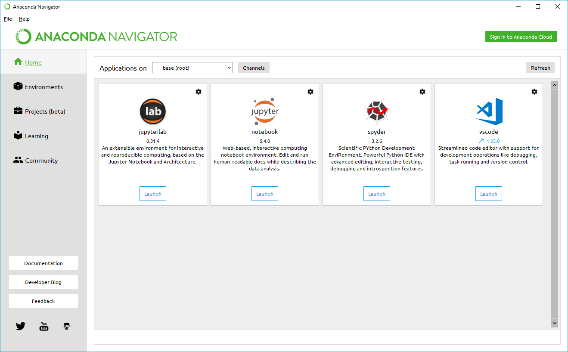
Developing and running Python
Jupyter notebook
Visual Studio Code (VSC)
VSC has now built-in Jupyter notebook support
Jupyter Lab
command prompt
Anaconda
Anaconda Distribution is the recommended way to configure and manage your Python development and running environment(s).
6

Slide 8
Installing Packages with pip
pip is the package installer for Python. You can use pip to install packages from the Python Package Index and other indexes.
You can use pip directly in Jupyter notebook or use Anaconda to manage environment configuration (preferred).
7

Slide 9
Installing Packages with pip – cont’d
install a package
upgrade a package
install a specific version
install a set of requirements
install from an alternate index
install from a local archive
$ pip install anypkg
$ pip install --upgrade anypkg
$ pip install anypkg==1.0.4
$ pip install -r reqsfile.txt
$ pip install --index-url http://my.package.repo/simple/ anypkg
$ pip install ./downloads/anypkg-1.0.1.tar.gz
8

Slide 10
Environments
What is an environment?
> a practical way to deal with Python’s packages
Issues:
many packages have not been around long enough to be tested with other packages that you might want to use with them
packages don’t always get updated quickly in response to updated dependences
solution:
Create virtual environments for hosting isolated projects using Anaconda Navigator
9

Slide 11
Environments – cont’d: conda
create an environment
activate an environment
deactivate an environment
install python
search for available packages
install a package
list installed packages
$ conda create --name myenv1 python
$ source activate myenv1
$ source deactivate
$ conda install python=version
$ conda search searchterm
$ conda install anypkg
$ conda list --name myenv1
10

Slide 12
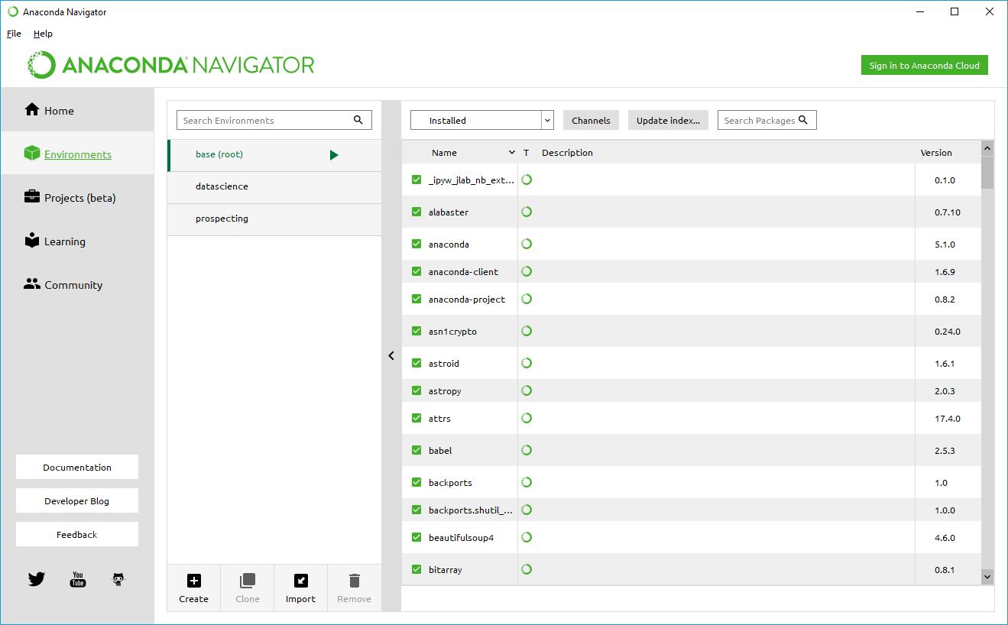
Environments – cont’d: Anaconda Navigator
implements conda via a GUI
create envs
switch between envs
list packages in an env
search for packages to add to env
env-specific app instances
set env (e.g. Python27)
launch Jupyter notebook to run Python 2.7 code
11

Slide 13
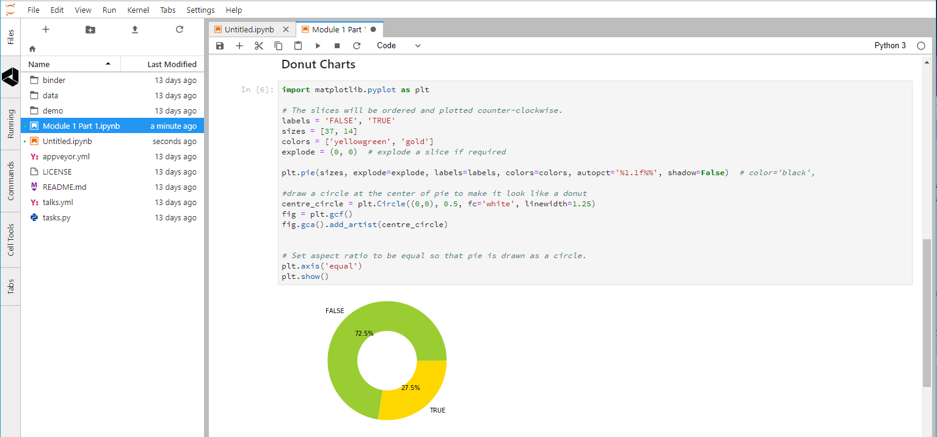
Jupyter Notebooks
shareable
environment-based
interactive or batch execution
> 40 languages
Python, R, Scala, …
Big Data support
Spark
12

Slide 14
Generic Data Types
Numeric | Text | Other
integer signed, unsigned | character unicode | Boolean true, false Binary 2^{n}
floating-point (‘float’) double = 2 x float | string character array 0-based or 1-based null-terminated or length-encoded usually immutable in OOP | unassigned null NA undefined NA +, − infinity
complex 2 x double (real, imaginary) | document key-value pairs (JSON strings) | BLOB images, video signals
13

Slide 15
Data Structures
lists
ordered, mixed-type, mutable
append, extend, insert, remove, pop, clear, index, count, sort, reverse, copy
comprehensions
tuples
ordered, mixed-type, immutable
support packing, unpacking of variables
sets
unordered, no duplicates
dictionaries
key-value pairs (unordered)
14

Slide 16
Functions
def funcName(param1, param2, defArg1 = 0, defArg2 = 100):
# code here
return someResult
optional parameters take default arguments if missing from function call
arguments are assigned to parameters in defined sequence unless named in call
return statement
optional
can return multiple items
scope is inherited from main (but not from a calling function)
15

Slide 17
Classes
2 underscores before/after init
the self parameter is not explicitly mapped to the function call
class phasor:
def __init__(self, r=0, p=0):
self.r = r
self.p = p
def real(self):
return (self.r * math.cos(self.p))
def imag(self):
return (self.r * math.sin(self.p))
z = phasor(2.7, 0.4 * math.pi)
16

Slide 18
Iteration
while condition
for iterator in list
continue
break
pass
a = ['Mary', 'had', 'a', 'little', 'lamb']
for w in a:
print(w)
for i in range(len(a)):
print (i, a[i])
class MyClass(object):
def meth_a(self):
pass
def meth_b(self):
print (“I'm meth_b”)
17

Slide 19
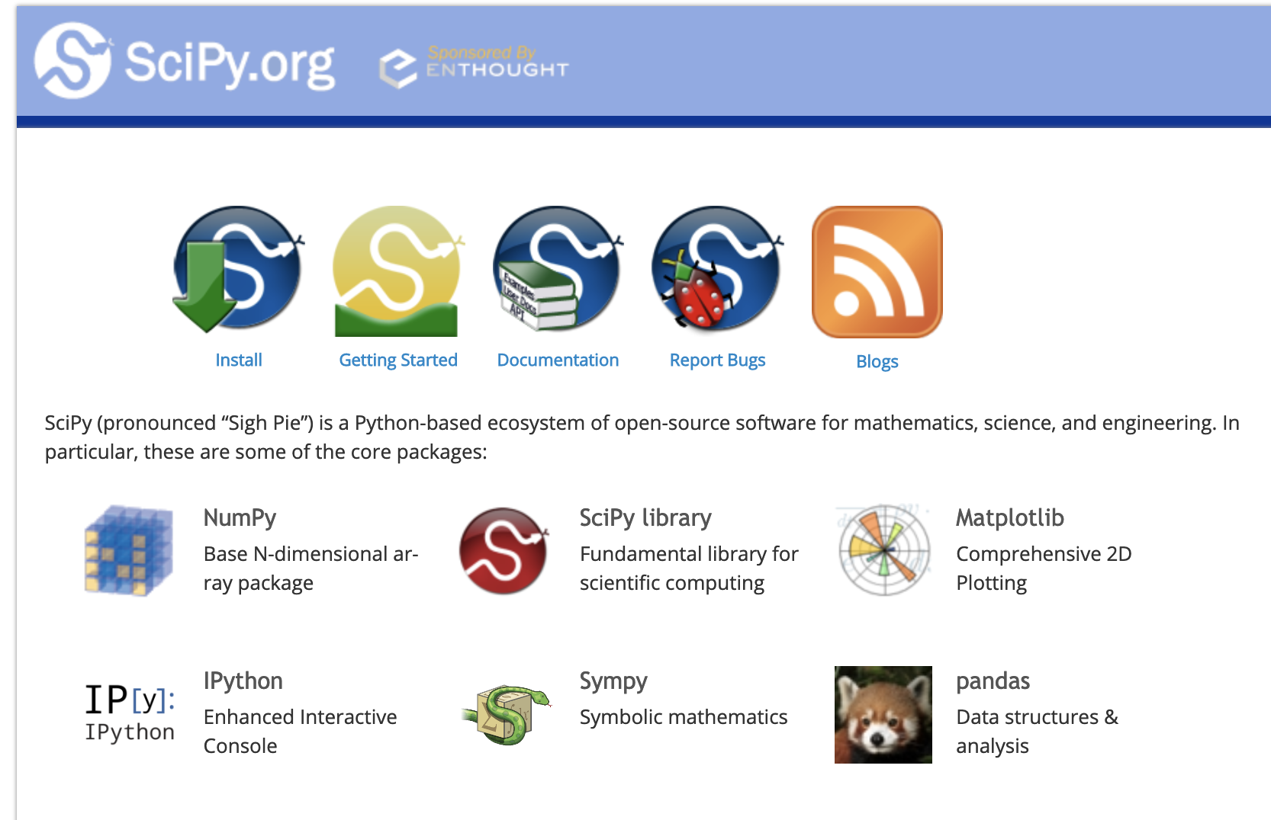
SciPy
SciPy (pronounced “Sigh Pie”) is a Python-based ecosystem of open-source software for mathematics, science, and engineering. In particular.
Main libraries (packages) include numpy, scipy, matplotlib, ipython, jupyter, pandas, sympy, nose
https://www.scipy.org/
19

Slide 20
NumPy
the fundamental package for scientific computing with Python
a powerful N-dimensional array object
sophisticated (broadcasting) functions
tools for integrating C/C++ and Fortran code
useful linear algebra, Fourier transform, and random number capabilities
import numpy as np
http://www.numpy.org/
20

Slide 21
Data Types in Python and NumPy
Type | Python | Numpy | Usage
byte byte array | b‘any string’ bytearray() |  | immutable mutable
integer | int() | 11 types | signed, unsigned 8, 16, 32, 64 bits, unlimited
floating-point | float() | 3 types | 16, 32, 64 bits
complex | complex() | 2 types | 64, 128 bits
unassigned | None |  | object myVar is not None
missing | nan | isnull(), notnull(), isnan() | float, object
21

Slide 22
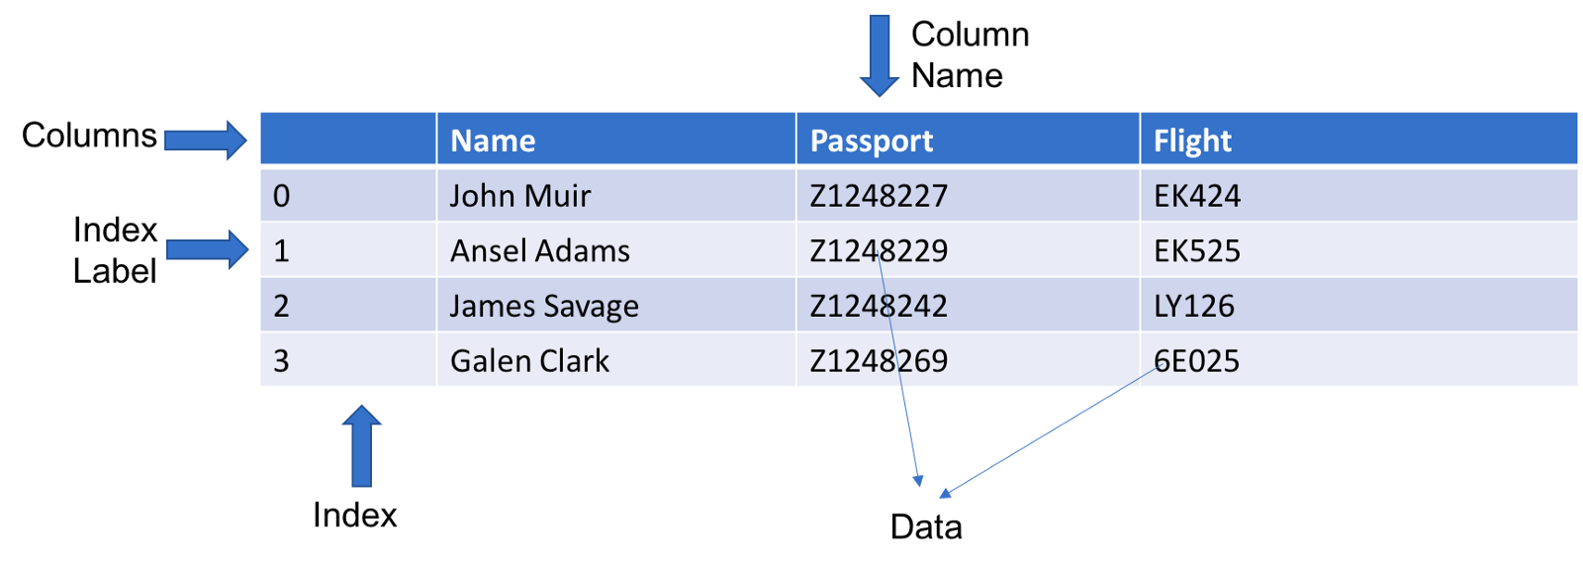
Pandas
Rich relational data analysis tool built on top of NumPy
Easy to use and highly performing APIs
A foundation for data wrangling, munging, preparation, etc in Python
Pandas Data Frame
22
Notes:
QUIZ: What is a DataFrame?

Slide 23
Pandas
high-performance, easy-to-use data structures and data analysis tools
DataFrame class
IO tools
data alignment
handling of missing data
manipulating data sets
reshaping, pivoting
slicing, dicing, subsetting
merging, joining
import pandas as pd
https://pandas.pydata.org/
22

Slide 24
Scikit-learn
biggest library of ML functions for Python
classification
regression
clustering
dimensional reduction
model selection & tuning
preprocessing
$ pip install -U scikit-learn
or
$ conda install scikit-learn
http://scikit-learn.org/stable/
23

Slide 25
Other Python Packages for Data Science
statsmodels
statistical modelling & testing
R-style formulae
import statsmodels.api as sm import statsmodels.formula.api as smf
BeautifulSoup
reading & parsing XML & HTML data
from bs4 import BeautifulSoup
Natural Language Toolkit
tokenising, tagging, analysing text
import nltk
24

Slide 26
Visualisation
matplotlib
histograms
bars
curves
surfaces
contours
maps
legends
annotations
primitives
Seaborn
based on matplotlib
prettier
more informative
more specialised
https://matplotlib.org/gallery.html https://seaborn.pydata.org/examples/index.html
31

Slide 27
Lab 1.2.1: Numpy
Explain the following Numpy methods and create working examples in Jupyter notebook using the data created for you in the beginning of the Lab notebook:
Structure your code using functions (prepare to discuss the value of using functions.
Explain the following NumPy methods and create working examples in Jupyter notebook using the data created for you in the beginning of the Lab notebook:
Structure your code using functions (prepare to discuss the value of using functions).
ndim
shape
Size
itemsize
data
linspace
mean
min
max
cumsum
std
sum
...
. Stretch exercise. Use matplot to explore the data
27

Slide 28
Lab 1.2.2: Pandas
Explore and download Employee Attrition file from Kaggle (https://www.kaggle.com/HRAnalyticRepository/employee-attrition-data)
Explain the following Pandas methods and create working examples in the lab Jupyter notebook .
Structure your code using functions (prepare to discuss the value of using functions.
read_csv
describe
loc
iloc
Index
sort_index
set_index
sample
…
2. Stretch exercise. Use matplot to explore some of the data in the data frame
28

Slide 29
Software Engineering Best Practices
Object-Oriented Programming
Refactoring
Coding for readability
Coding for testability
Documenting
41

Slide 30
Object-Oriented Programming
an object encapsulates
data (attributes)
procedures (methods)
a class is a prototype for an object
instantiation: creating an object (in memory) from a class definition
def: encapsulation
attributes of the class should only be accessible by methods of the class
get()
set()
42

Slide 31
Creating and Using a Class in Python
class myclass:
def __init__(self, param1, …):
# initialise class attributes
def method1(self, ):
# do something
return (method1result)
obj1 = myclass(arg1, …)
define class by name
initialisation code
only self is mandatory
may use arguments passed from caller
define methods
only self is mandatory
may use arguments passed from caller
may use attributes
may return a value
invoke class name in assignment to instantiate an object
omit self
43

Slide 32
Other OOP Concepts
def: abstraction
data and procedures that do not need to be accessible to the caller should be hidden within the class
def: inheritance
new classes can be based on and extend an existing class
def: polymorphism
a class can implement multiple methods with the same name and function, but which operate on different parameters (type and/or number)
44

Slide 33
Refactoring
def: Restructuring existing code without changing its behaviour
Examples
abstract reused code to functions
generalise functions (polymorphism?)
use get, set methods
simplify structure of nested loops, logic
minimise use of global variables
in Python, this includes all variables defined in main program
45

Slide 34
Coding for Readability (Maintainability)
Examples
indent blocks
mandatory in Python
white space
between groups of lines
between symbols
comments: inline (to explain logic, return values, etc.)
sectional (to explain functional blocks)
header (to explain program or module)
purpose, authors, date
dependences, assumptions
comments are for coders
maintaining or extending your code
documentation is for users
explaining what the application is for and how to use it
46

Slide 35
Coding for Testability
Examples
avoid side-effects in functions
enable testing via compiler flags
##define TEST_MODE
#if TEST_MODE
print(“test mode activated”)
#endif
write tests before functions
specify return type(s) supported
test return type(s), validity
pass sample data as arguments
print result
test frequently
avoid marathon coding sessions
code top-down
create wireframe code to test logic, structures
fill in the details later
pytest
https://docs.pytest.org/en/latest/
47

Slide 36
Homework
Create a GitHub account (if you don’t already have one).
Optional: Install GitHub Desktop
url: https://desktop.github.com
50

Slide 37
Version Control with Git & GitHub
Forking
Cloning
Communicating issues
Managing notifications
Creating branches
Making commits
Introducing changes with Pull Requests
52

Slide 38


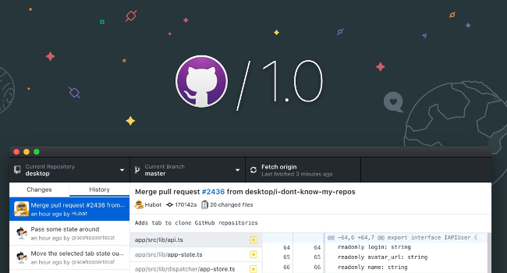
Git & GitHub
web-based, API
host code, data, resources
version control
integrates with open-source and commercial IDE tools
share, collaborate
branching
showcase achievements
command line & desktop versions
53

Slide 39
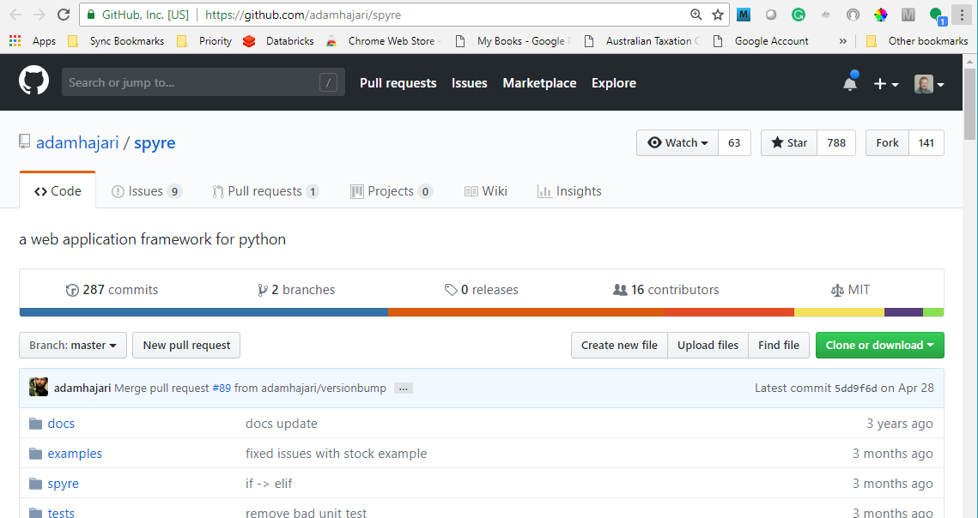
GitHub: Forking & Cloning a Repo
fork: make your own copy of someone else’s repo, on GitHub
click <Fork>
clone: create a (working) copy of the repo on your computer
GitHub Desktop procedure:
click <Clone or download>
click <Open in Desktop>
navigate to target (local) folder
click <Clone>
command-line procedure:
$ cd yourpath
$ git clone https://github.com/ yourgithubname/yourgithubrepo
54

Slide 40
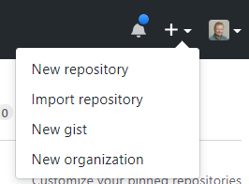
GitHub: Creating a New Repo
from your GitHub home page
<New repository>
clone the repo to your local drive
copy files, folders into it
commit changes
generate a pull request
Creating a branch
to allow development in isolation from source repo
protects your changes from changes to source
rejoin main branch when ready
55

Slide 41
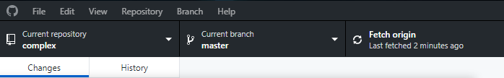
GitHub: Refreshing Local Repo from Source
Desktop
<Fetch origin>
Command-line
$ git checkout master
$ git fetch upstream
$ git merge upstream/master
Ensure you’re in the master branch
Grab the latest changes from the master
Merge the master changes with your repo
56

Slide 42
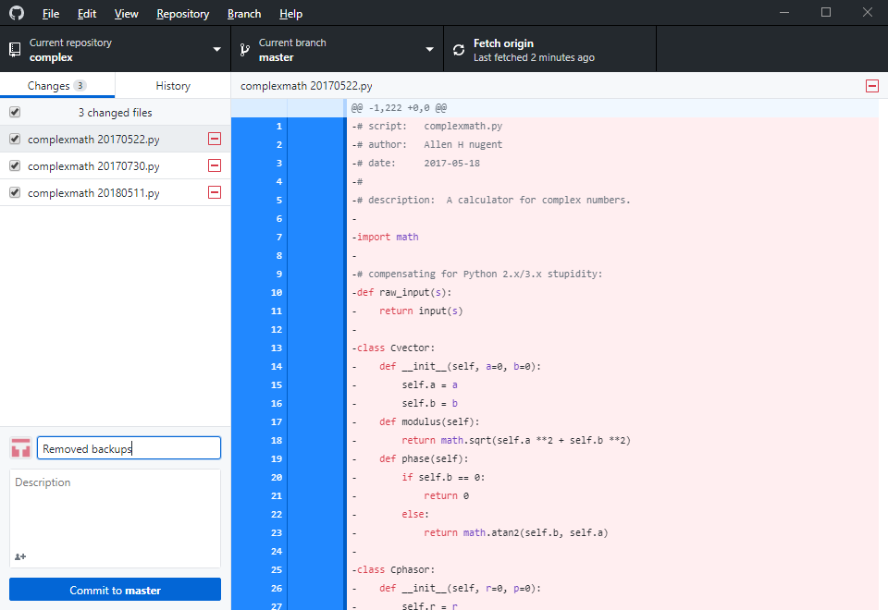
GitHub: Commit & Pull Request
Desktop
enter comments in text box
<Commit to master>
Repository > Push or <Push origin>
57

Slide 43
GitHub: Commit & Pull Request
Command-line
commit
$ git status
$ git add filename
$ git add .
$ git commit -m your_comments
$ git status
pull request
$ git push origin master
show changes
stage one file
stage all change
commit file(s), with comments
origin = your GitHub repo (forked from source repo)
master = source repo
58

Slide 44
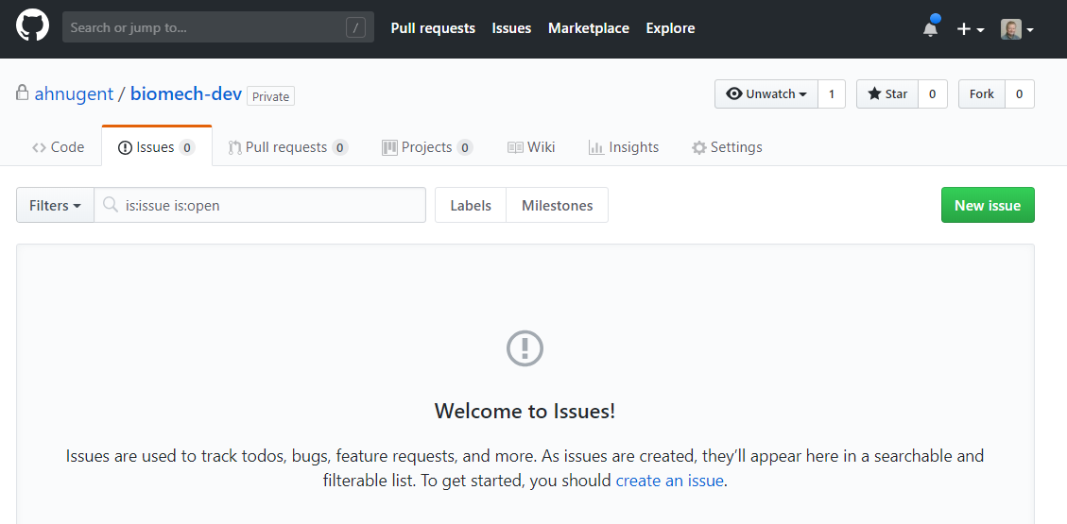
GitHub: Issues
track
issues / bugs
to-do items
feature requests
search
filter
59

Slide 45
GitHub: Notifications
Triggers
you, a team member, or a parent team are mentioned
you're assigned to an issue or pull request
a comment is added in a conversation you're subscribed to
a commit is made to a pull request you're subscribed to
you open, comment on, or close an issue or pull request
a review is submitted that approves or requests changes to a pull request you're subscribed to
you or a team member are requested to review a pull request
you or a team member are the designated owner of a file affected by a pull request
you create or reply to a team discussion
60

Slide 46

Lab 1.2.3: Setting Up GitHub
Purpose:
To establish a GitHub repo and develop basic skills for collaborating and maintaining projects.
Tools & Resources:
GitHub / GitHub Desktop
Materials:
‘Lab 1.2.5.docx’
61

Slide 47
Questions?

Slide 48
End of presentation

